Slide 1



NeoFinTech
Revolutionizing Banking with Spring Boot, React JS, and MySQL
Mentor: Parvathy M.
Team 4:
Yegyanath, Ritesh Rai, Sharan Prasath, Preksha Grover, Pranav B

Slide 2


Explore NeoFinTech:
Project Overview
Key Features
Tech Stack Used
Project Architecture
Customer Portal ( with UI screenshots)
Admin Portal (with UI screenshots)
JWT Authentication
Challenges Faced
Future Enhancements

Slide 3

Project Overview
In today's fast-paced world, online banking has become a cornerstone of financial services.
Internet banking has fundamentally transformed the way individuals and businesses manage their finances. It has become an indispensable tool in today's digital age.
NeoFinTech is here to revolutionize this experience. The Bank Application brings together cutting-edge technologies to offer seamless, secure, and efficient online banking services.

Slide 4



NeoFinTech Power Pack - Unleash These Features!
User Registration and Login
Your journey begins with a seamless registration process and secure login, putting you in control of your finances.
Account Overview
Gain instant insights into your accounts - balances, pending transactions, and more - at a glance.
Fund Transfer
Transfer funds effortlessly between your accounts or send money to loved ones with just a few clicks.
Account Statement Generation
Access and download detailed account statements for a comprehensive view of your financial history.

Slide 5



Password Change
Ensure your account's security with ease by updating your password whenever you need.
Account Settings
Customize your banking experience with personalized settings to suit your preferences.
Deposit and Withdrawal
Deposit funds securely and withdraw with convenience, anytime, anywhere.

Slide 6


Transaction History
Track your financial journey with a complete transaction history and search functionality.
Admin Dashboard
For administrators, gain control over accounts, transactions, and overall system management.
Secure Logout
Log out securely to protect your banking information when you're done.

Slide 7










Tech Stack Used
Frontend: React JS
Backend: Spring Boot
Database: MySQL
IDEs: VS Code, Eclipse
Testing: Postman, Mockito, Junit
These cutting-edge technologies power NeoFinTech, delivering a robust and responsive application.

Slide 8




Customer
Project Architecture
Request
Customer API
Admin API
Login
Response
Admin
Seamless integration and secure communication ensure NeoFinTech's reliability.

Slide 9

Customer Portal
Accessible and user-friendly interface
Perform transactions effortlessly
Check account balances and more
User Friendly User Dashboard
Data Security
Account Statement
Account Summary

Slide 10
CUSTOMER PORTAL SCREENSHOTS

Slide 11

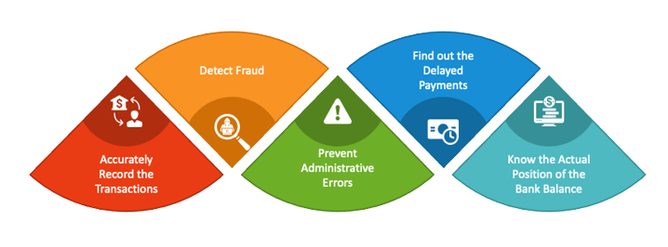
Admin Portal
Manages user accounts
View comprehensive transaction details
Enable/disable accounts as needed

Slide 12
ADMIN PORTAL SCREENSHOTS

Slide 13
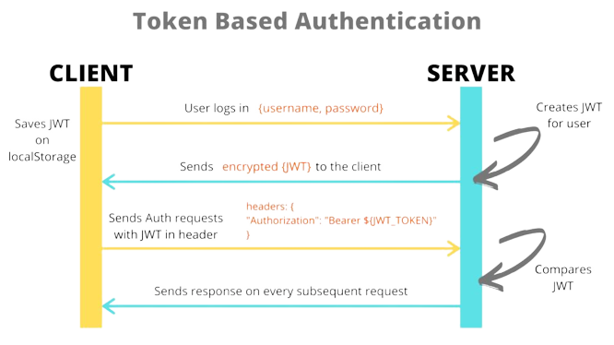
JWT Authentication
JWT (JSON Web Token) provides secure user authentication
Ensures data confidentiality and integrity
Simplifies user login and authorization
JWT Authentication ensures top-notch security for user data.

Slide 14

Why NeoFinTech? (Positives)
Customer Convenience
Enhanced Security with JWT
Efficient Admin Controls
Quick Transactions
Real-time Monitoring
and many more…………

Slide 15

Integration complexity
Ensuring data security
Resource constraints
Time Constraint

Slide 16
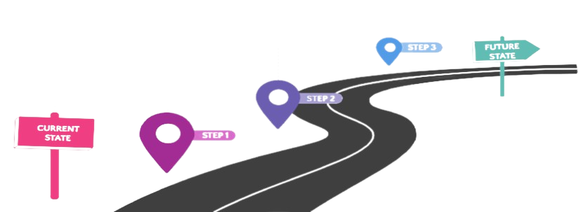
Future Enhancements
Innovating and Expanding
(Blockchain and Cryptocurrency,
Voice Banking, Enhanced UX, LLMs)
Expanding Services and User Experience
(Investment Services, Credit services,
AI-Powered Financial Insights)
Strengthening the Foundation
(Biometric auth, AI chatbot etc.)

Slide 17
Conclusion
Throughout this journey, our teamwork and collaboration have been instrumental.
Our mentor’s expertise and mentorship have empowered us to navigate complex technologies with confidence.
We ventured into the world of technology, diving deep into Spring Boot, React JS, MySQL, and more, gaining valuable insights and skills along the way.

